Slide 1
Reliability
Wenchao Ma
University of Minnesota
Notes:
in order for survey research measurements to be accurate, they must be precise and stable. Validity and reliability are closely related research concepts. Validity asks, “Is this measurement truly representative of the concept under study?” Reliability asks “If we repeat this measurement multiple times, will we obtain consistent results?”
However, they are not all-or-nothing concepts; rather, they comprise a spectrum from low to high, and it is in fact rare that any item on a survey is 100% valid and reliable.

Slide 2
Classical Test Theory
X
T
E
Notes:
X represents the observed score. The term observed does not mean that we can literally observe the value of, for example, a person’s level of depression by looking at them. Instead it refers to the values that have been assigned on the basis of the measurement instrument being used. the observed scores are simply the values, or scores, we have obtained with our measurement instrument.
The term E represents the part of the score that is due to error or to inconsistencies in measurement
the term T refers to a respondent’s true score. The true score is an important, though hypothetical, entity in classical test theory. It represents the score a respondent would obtain if our measurements were free of all error. The fact that measurements are never completely free of error is what makes the true score hypothetical rather than observed.
a respondent’s observed score is made up of two parts: the true score and the error score. The true score can be conceptualized as the average score that would be obtained if we were able to give a test to a respondent hundreds of times, wiping out her or his memory after each testing. Because the error scores are assumed to be random, some errors would cause the observed score to be higher than the true score, but some would cause it to be lower.
Concerns over reliability and validity are really concerns about error: Any strategy that decreases measurement error will improve both the reliability and validity of the measure.

Slide 3
Classical Test Theory
Random error
Systematic error
Random in nature
Occurs when source of error always increase or decrease a true score
Will increase and decrease a person’s score by exactly the same amount with infinite testing
Cancels itself out
Lowers reliability of a test
Does not lower reliability of a test since the test is reliably inaccurate by the same amount each time
Notes:
In order to be reliable, a measurement must be dependable, replicable, and consistent. In other words, the measurement must minimize random error. Random error occurs in two ways: (1) when an individual randomly guesses a response, perhaps because the question is poorly worded or has misleading directions, and (2) when an individual accidentally chooses a response unintentionally. In both cases, the response given is not reflective of a “true” value; it is not an accurate response,

Slide 4
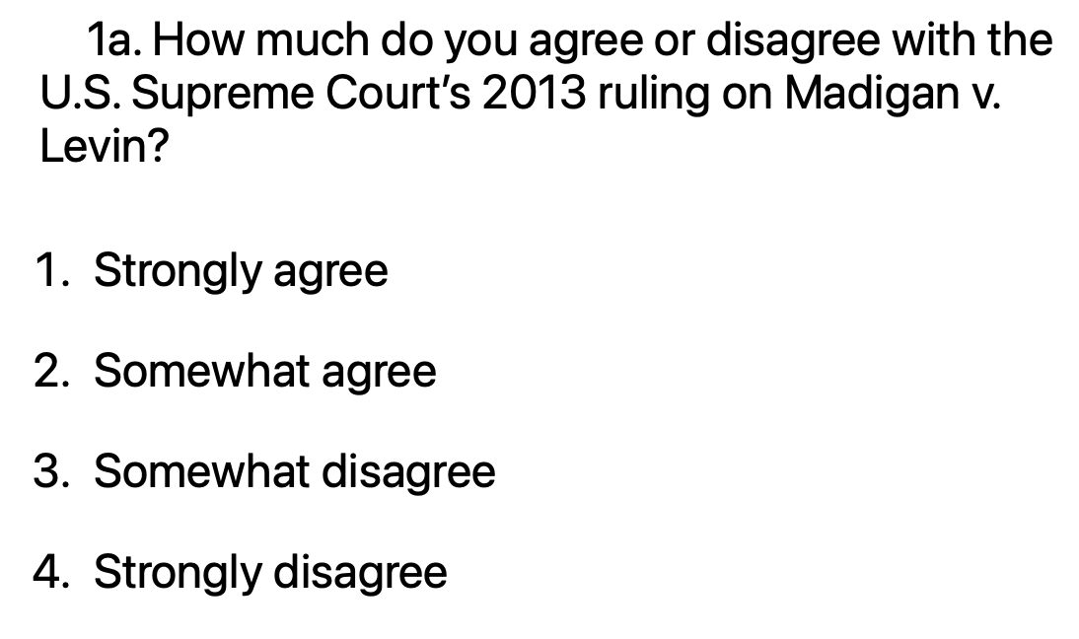
Reliability in Survey
If researchers are trying to determine how an individual feels about age discrimination in the workplace, they might ask this question:
Notes:
This question will probably suffer low reliability, since very few people will know much about Madigan v. Levin. Therefore, a question of this nature may be prone to a guessed response (which means it is not a very reliable measure). One solution would be to include a “don’t know” response. This might improve reliability, but the researchers would still not know what the population under study feels about age discrimination in the workplace.

Slide 5
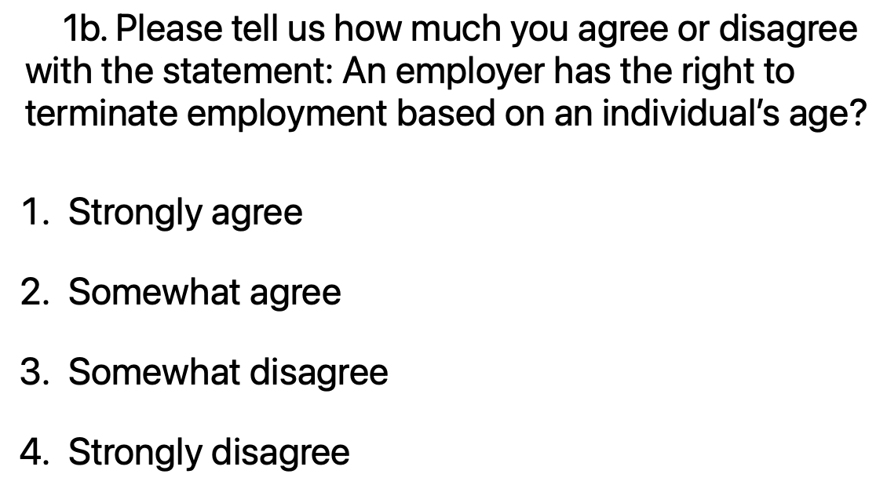
Reliability in Survey
Notes:
This question is likely to be a more reliable question, because it does not assume that an individual has knowledge about a specific legal case, and many people have opinions on workplace discrimination. Individuals will thus be less likely to randomly guess, so we may count on a more consistent response to this question.

Slide 6
Estimating reliability
X=T+E

Slide 7
Estimating Reliability
The theoretical reliability coefficient is not practical; we do not know each person’s true score.
Nevertheless, we can estimate the theoretical coefficient with the sample correlation between scores on two parallel tests.

Slide 8
Reliability
Reliability refers to the precision of the measurements, or the consistency of scores produced by a test.
Reliability is not a property of the test, but that of scores.
If scores are consistent, the measurement is reliable.
Scores could be inconsistent in varied ways – reliability should be assessed accordingly

Slide 9
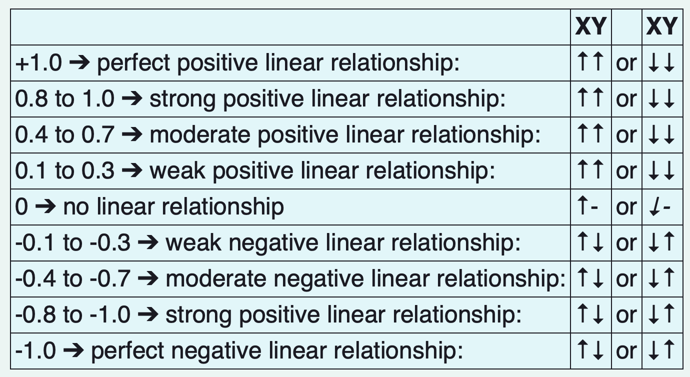
Estimating reliability

Slide 10

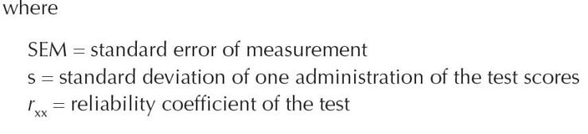
Interpreting Reliability Coefficients
Standard error of measurement is an index of the amount of uncertainty or error expected in an individual’s observed test score
Allows us to quantify the amount of variation in a person’s observed score that measurement error would most likely cause
Notes:
The reliability coefficients discussed thus far are useful for summarizing the reliability of a set of test scores for a group of people. But they do not provide direct information about how accurate an individual’s observed score might be. we can use the reliability coefficient to estimate the amount of error in a score. This information is provided by the standard error of measurement (SEM), defined as the standard deviation of an individual’s observed scores around their true score.

Slide 11

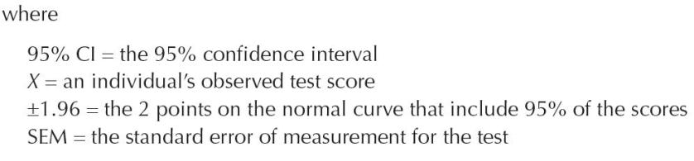
Interpreting Reliability Coefficients
Confidence interval is a range of scores that we feel confident about test taker’s true score

Slide 12
Types of reliability
Test–retest reliability
consistency of scores over time
Alternate forms reliability
consistency of scores over multiple test forms
Internal consistency
consistency of scores across test items
Interrater agreement
consistency of scores across raters
Notes:
Test–retest reliability measures, sometimes called coefficients of stability, are obtained when the researcher is concerned with consistency of scores over time. Alternate forms reliability measures, or coefficients of equivalence, are of interest for situations in which there are multiple test forms designed to provide equivalent scores. Internal consistency measures of reliability reflect the degree to which the items on a test are interrelated. Internal consistency is important for any test that contains multiple items that will be summed or averaged to obtain a total score. These coefficients are discussed in Chapter 8. Finally, measures of interrater agreement, discussed in Chapter 9, assess the degree to which scores are consistent across raters.

Slide 13
Test–retest reliability
Test–retest reliability is concerned with the consistency, or stability, of test scores across different time points.
Test scores can change across time because of
lack of reliability of the measure being used,
changes in respondents’ true levels of the construct being measured, or
a combination of these.
Notes:
This type of reliability is important for situations in which scores will be obtained at different times and compared, such as in a pre–posttest situation. Test–retest reliability information is also important for situations in which test scores will be used for diagnosis, selection, or placement decisions. When test scores are used in making such decisions, the outcome, in the form of a treatment or placement, does not typically occur immediately but is delayed to some extent.
assume a respondent is asked, “How many individuals live in your household?” at two different time points (with the second point coming a week or so after the first). The coefficient measuring the correlation between the two answers (Measure 1 and Measure 2) will indicate the level of consistency between the scores.

Slide 14
How many times have you attended religious services in your entire life? ______ (T1/T2)
Notes:
Using this measurement for religiosity at two points in time will likely produce low reliability, given that the question is assessing religious service attendance over the course of an individual’s entire life—a very long and difficult time span to consider.

Slide 15
In the previous month, how many times have you attended religious services? (T1/T2)
0
1–2
3–4
5 or more
Notes:
By recasting the question to cover a much shorter, more finite, and more recent time period, this question makes a much more reasonable demand on respondents’ recall.

Slide 16
Recommended Values for Coefficients of Stability
Crocker and Algina (1986, p. 133) state that “well-constructed” noncognitive scales can yield scores with coefficients in the .80s, and scores from aptitude tests can have values into the .90s.
Coefficients of stability would likely be higher if the time interval had been shorter, and lower if the time interval had been longer.
Notes:
How high should stability coefficients be? The higher the better,

Slide 17
Alternative forms reliability
In many situations, more than one version of a test is available.
These versions are designed to be interchangeable.
Notes:
In many situations, more than one version of a test is available. These versions are designed to be interchangeable, such that the particular version taken does not influence respondents’ scores. Such alternate forms of tests are perhaps most common in educational testing, in which multiple forms of tests are often prepared in an effort to prevent cheating.

Slide 18
Alternative forms reliability
 | Form A | Form B
Student #1 | 80 | 86
Student #2 | 98 | 96
Student #3 | 67 | 75
Student #4 | 89 | 84
Student #5 | 73 | 69
… | … | …
To assess alternate forms or equivalent forms reliability, one can use
coefficient of equivalence, which is simply the correlation between the two scores.
Notes:
Estimates of equivalence coefficients are obtained by administering the two forms of interest to the same respondents and then correlating the two sets of scores.

Slide 19
Recommended Values for Coefficients of Equivalence
Coefficients of equivalence are generally quite high.
Raykov and Marcoulides (2011) state that values should be at least .80 and preferably in the .90s.

Slide 20
Combining Alternate Forms and Test–Retest Reliability
Researchers may be interested in using different forms of an instrument at different time points.
To obtain information on the extent of these combined sources of measurement error, the two forms should be administered to the same sample of respondents at two occasions that are separated by the time interval of interest.

Slide 21
Combining Alternate Forms and Test–Retest Reliability
 | Form A at Time 1 | Form B at Time 2
Student #1 | 80 | 86
Student #2 | 98 | 96
Student #3 | 67 | 75
Student #4 | 89 | 84
Student #5 | 73 | 69
… | … | …
To assess alternate forms and test-retest reliability, one can use
coefficient of stability and equivalence, which is simply the correlation between the two scores.
Notes:
The correlation between scores from the two administrations is the coefficient of interest, sometimes referred to as a coefficient of stability and equivalence.

Slide 22
Recommended Values for Coefficients of Stability and Equivalence
Estimated values for coefficients of equivalence and stability are typically lower than those for either stability or equivalence alone because they combine the two sources of score inconsistencies.
Values for coefficients of equivalence and stability should be at least .70, and values of .80 are not unreasonable.

Slide 23
Internal Consistency
I consider myself to be
Not very religious
Somewhat religious
Very religious
I attend religious services
Not very often
Somewhat often
Very often
I read religious texts
Not very often
Somewhat often
Very often
Notes:
Now let us consider a set of questions measuring similar concept. Internal consistency asks, “How well do all of the items on a religiosity scale correspond with each other?” The measure is thus not related to a single item but rather assesses how a whole group of conceptually similar questions hang together.

Slide 24
Internal Consistency
Internal Consistency concerns about the source of error from the items of the test.
An early approach to estimating the internal reliability of a test was to split the test into two halves and correlate the resulting two scores, followed by an adjustment.
Coefficient alpha is one of the more popular measures for internal consistency; equivalent to the average of all possible split halves of a test
Notes:
Measurement error may be caused by confusing wording, items that are irrelevant to the construct, vocabulary that is unfamiliar to respondents, or cognitive items that have more than one answer. Problems such as these will result in inconsistent responses for two reasons. First, not all respondents will be affected in the same manner by such wording. Second, such wording interferes with respondents’ ability to express their true level of the construct. Internal consistency coefficients assess the degree to which responses are consistent across items within a scale.
This approach mimics that of correlating scores on two parallel forms of a test, or on two scores from the same test obtained at different times, but it can be used in situations where neither scores from two test forms nor scores from two test administrations are available.

Slide 25
Internal Consistency
Coefficient alpha is only suitable under some strong assumptions, which are hard to met in practice
Coefficient omega can often overcome the deficiencies of coefficient alpha
Notes:
when the items are unidimensional (measuring the same latent trait), the sample coefficient alpha yields consistent estimate of reliability only when all the items have equal covariance with the true score, called tau-equivalence. But this assumption is seldom met in practice with educational and psychological scales.
A measure that overcomes the deficiencies of alpha is coefficient omega, which is based on a one-factor model. In particular, when the covariance among the items can be approximately accounted for by a one-factor model, the formulation of coefficient omega closely matches the definition of reliability

Slide 26
Misconceptions about Coefficient Alpha
α is one of the most popular psychometric indices
There are several common misconceptions about its interpretation
Let’s talk about what α actually is and what it is not

Slide 27
What α is; What α is not
What α is | What α is not
1. Index of internal consistency | 1. Indicator of dimensionality
2. Mean of all possible split-half reliability coefficients | 2. Lower-bound of reliability
3. Estimate of reliability in certain circumstances

Slide 28
Recommended Values for Internal Consistency Indices
Raykov and Marcoulides (2011) recommend values of at least .80.
Nunnally’s (1978) provides the following guidelines:
.70 for scales in the initial stages of development;
.80 for “basic research scales,” and
.90 as minimum for use in clinical settings.
Kaplan and Sarcuzzo (2001) suggest values of up to .95 for clinical settings.
Notes:
The higher values for clinical decisions reflect the serious consequences of such decisions and the need for correspondingly higher standards.

Slide 29
How to improve reliability?
Clarity: Clearly written surveys that avoid ambiguous language in questions and response options are much more reliable sources of data than less carefully constructed instruments
Brevity: Not only the language, but the mere number of possible response options can strongly influence how an individual is going to respond
Length: reliability is usually increased as test length increases.

Slide 30
1a. How many times have you attended religious services in the past year? ______
1b. How many times have you attended religious services in the past year?
0
1–3
4–6
7–10
10–12
13 or more
1c. How many times have you attended religious services in the past year?
0
1–3
4–5
6 or more
Notes:
Consider this example, which compares a question with few response options to another version with many response options and to a third version with open-ended questions with unlimited response options. The question with the fewest response options will have the more reliability, given it requires less concentration and memory.

